Slide 1
Simplified S3 Bucket Application

Slide 2
Introduction
Application details with screens captured
Q&A

Slide 3
Introduction 1. The user should be able to post a file to the system from outside kubernetes 2. user only posts files with unique names 3. If the user posts a file with the same name, the previous copy of the file should be overwritten. 4. There should always be 3 copies of the files stored on the system. 5. There should be 3 replicas of the service running behind a cluster IP service. 6. The user should be able to perform a read-after-write action with a 5 second delay. This means that as a user I should be able to post a file, wait for 5 seconds and Get the file without failure using the same end point, but different HTTP verbs and parameters from outside the k8s. 7. Only txt file is to be expected as inputs. No images or non txt files will be used to test. The file size will be 1kb or less. 8. Files should be posted via Http requests

Slide 4
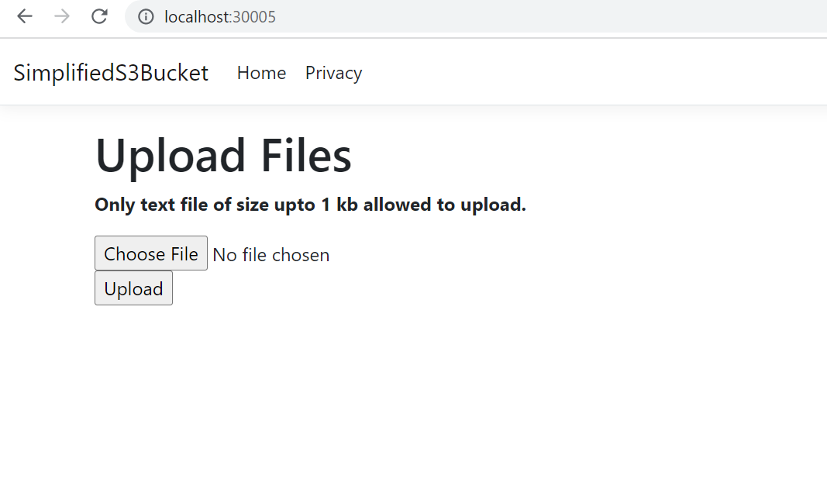
After successful installation of application, it is accessible by url http://localhost:30005/

Slide 5
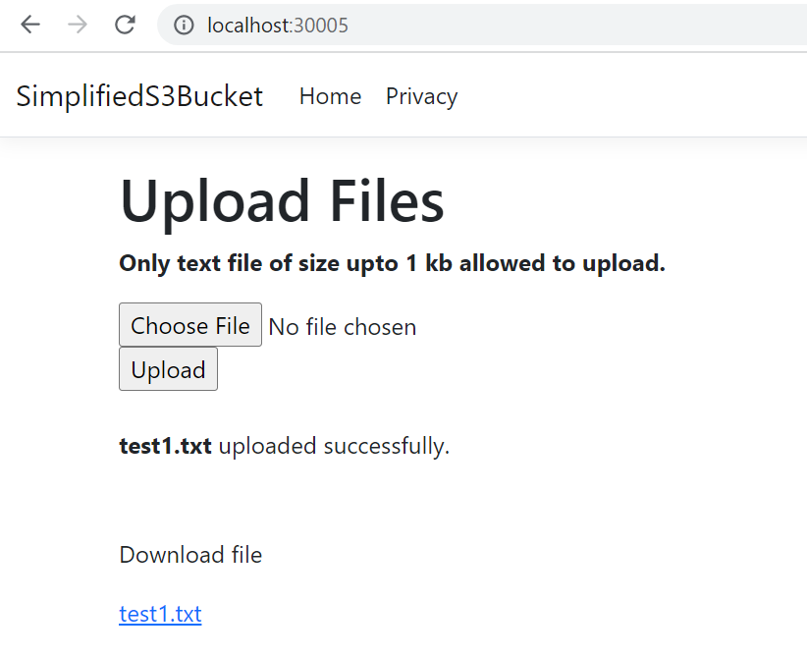
Select file and click on upload button to upload file which can be downloaded by clicking on link

Slide 6
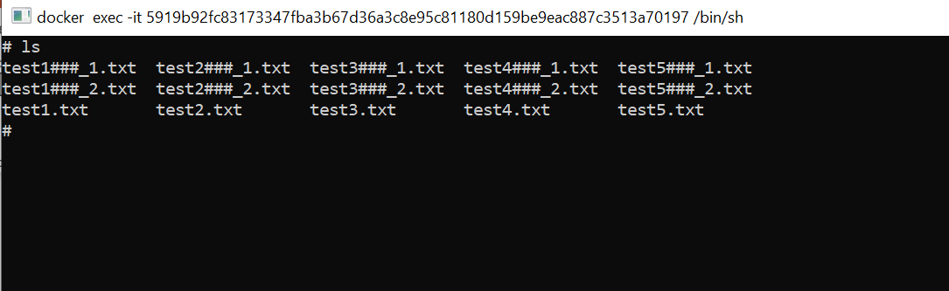
3 copies of uploaded file will be stored in Kubernetes persistent volume at path /data/simplifieds3bucket as shown below, by appending ###_1 and ###_2 to original file.

Slide 7
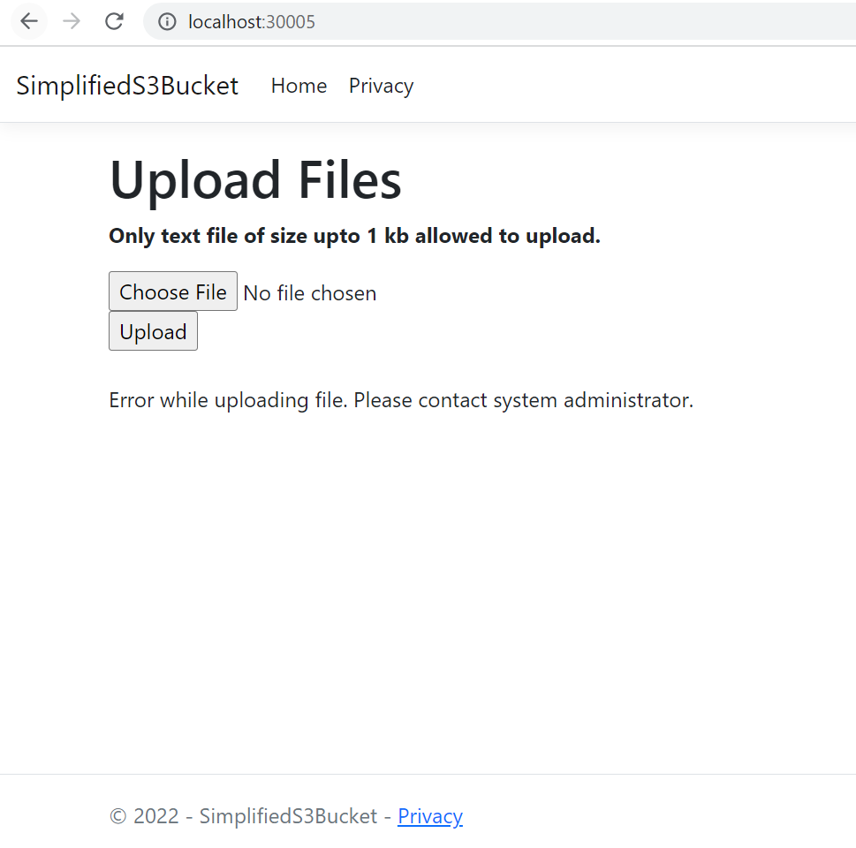
If any error will be shown as below

Slide 8
Thank you

